Slide 1
AUTOENCODER

Slide 2
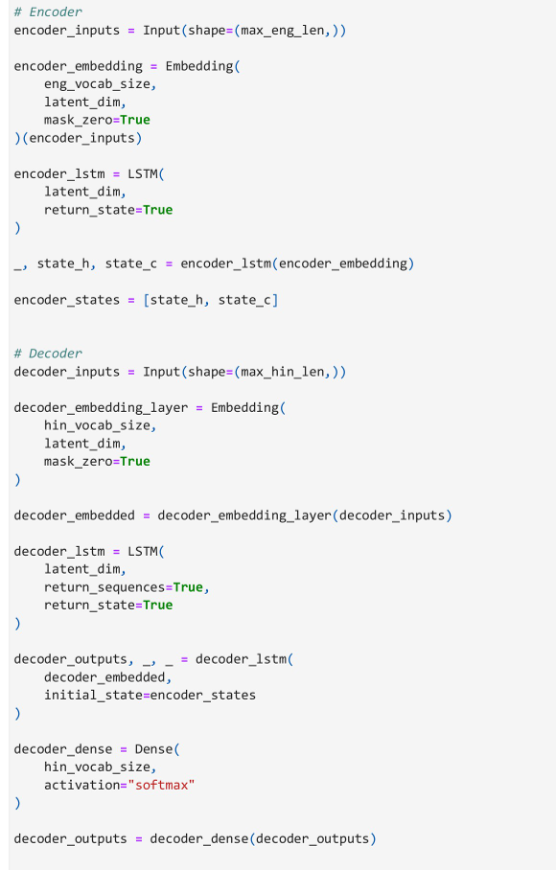

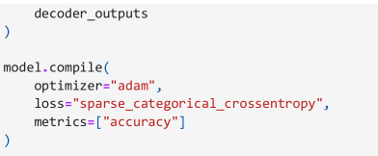
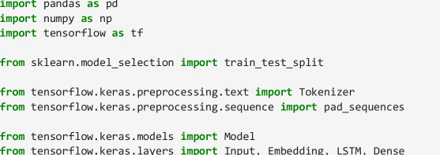
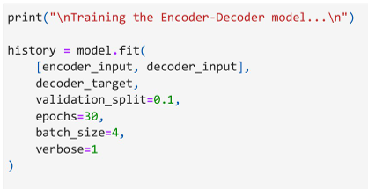
*Delete empty rows,
*convert English,hindi rows to str, strip it
*Select data with only English&hindi,drop
duplicated
Add “StartSeq “, “ EndSeq” to hindi col values, but create a dictionary without them
Train test split the dataset,
Define oov tokenizer for English,hindi use (fit_on_texts, texts_to_sequence) to define encoder,decoder train,test and target for decoder only
Pad sequence 6 of them
Find max_vocab size for both, define latent_dim

Slide 3
NIFTY 50

Slide 4
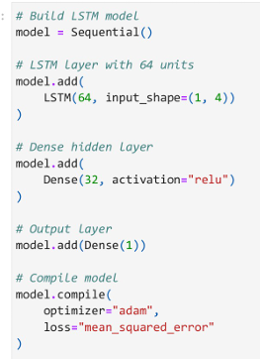
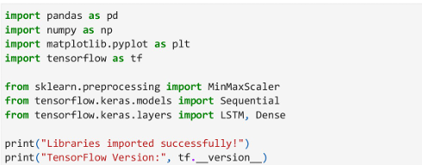
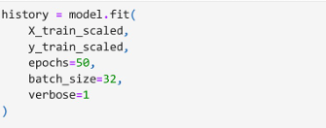
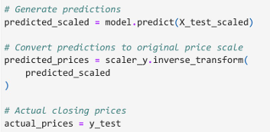
*Strip white spaces in all col names
*convert “SYMBOL” entries to string, strip it
*set data to only those with NIFTY as symbol
*redfine data to only include needed col entries
*Rename the columns
*use pd.to_datetime(), pd.to_numerical()
*sort them chronologically with .sort_values() and set reset_index(drop=True)
*reshape the x_train,x_test
*Add Previous_Close by .shift(1) on data[“Close”]
*drop null rows,reset index

Slide 5
SIMPLE RNN

Slide 6
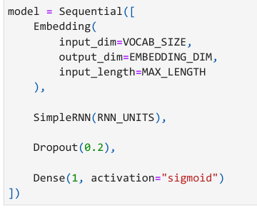
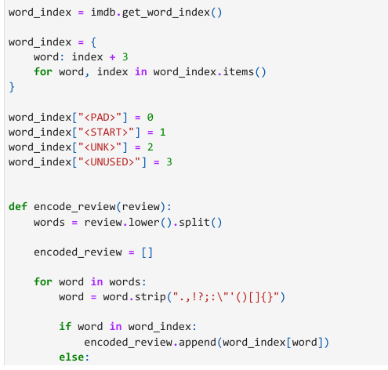

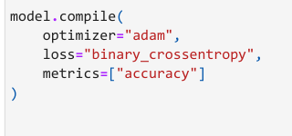
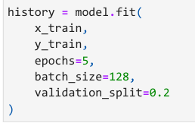
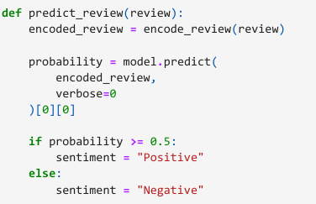
*after loading dataset, do pad_sequences() for x_train,x_test

Slide 7
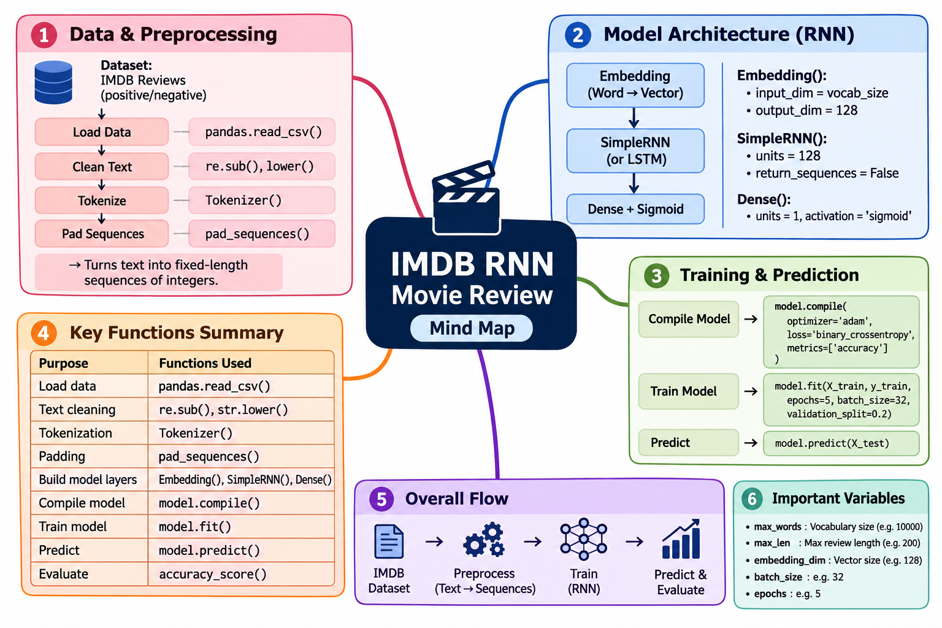

Slide 8
CNN CUSTOM DATASET

Slide 9
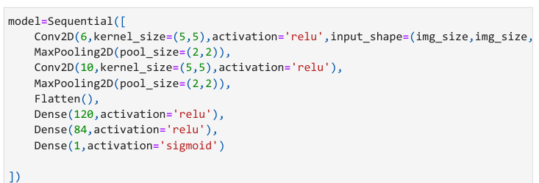
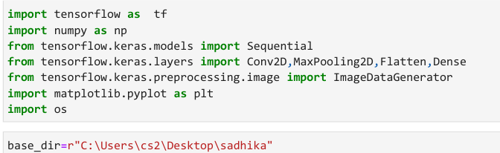
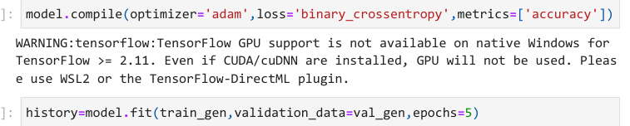

*create a ImageDataGenerator() object, by setting parameters
(rescale, validation_split, shear_range, zoom_range, horizontal_flip)
*create train_gen, val_gen using .flow_from_directory() on ImageDataGenerator with parameters ( (The path directory) , target_size, batch_size, class_mode, subset, shuffle)

Slide 10
VGG19

Slide 11
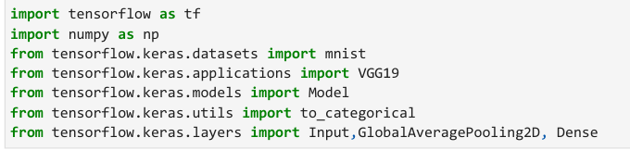
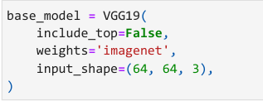

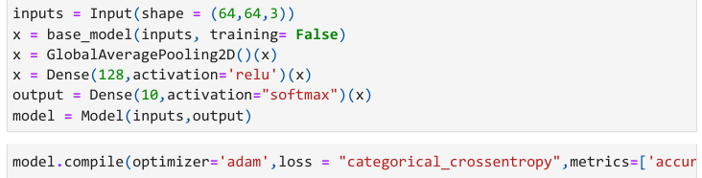
*after loading dataset, add the channel dim to x_train, y_test using np.expand_dim(), use np.repeat() to change it to 3
*resize x_train, x_test using tf.keras.image.resize()
Store the y_train, y_test categorical hot encoded vector values using to_categorical()
* After creating VGG19 model, set .trainable = False

Slide 12
CNN

Slide 13
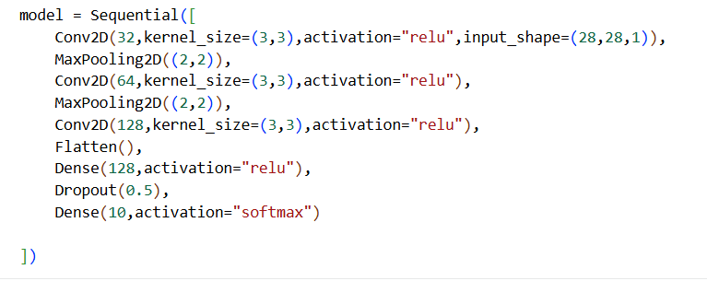
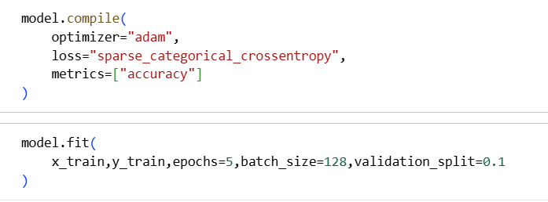
*after loading dataset,divide x_train,y_train values by 255.0, add channel dim for them as well

Slide 14
BACKPROPOGATION

Slide 15



